Slide 1
FORECASTING NATIONAL-LEVEL SELF-HARM TREND AND SOCIAL NETWORK

Slide 2
ABSTRACT
Self-harm pertains to actions of self-inflicted poisoning or injury that lead to either nonfatal injuries or death, irrespective of the individual’s intention. Self-harm incidents not only cause loss to individuals but also incur a negative impact on the nation’s economy. Studies have demonstrated an increase in trends of self-harm that are correlated with the emergence of technological advancements and swift urban expansion in developing countries. The capacity to nowcast and forecast national-level patterns of self-harm trends could be imperative to policymakers and stakeholders in the public health sector, as it would enable them to implement prompt measures to counteract the underlying factors or avert these projected calamities. Prior research has utilized historical data to predict self-harm trends at the population level in various nations using conventional statistical forecasting methods. However, in some countries, such historical statistics may be challenging to obtain or insufficient for accurate prediction, impeding the ability to comprehend and project the national self-harm landscape in a timely manner.

Slide 3
INTRODUCTION
Self-harm, a critical public health issue, has garnered increasing attention due to its rising prevalence and severe impact on individuals and communities. Accurate forecasting of self-harm trends is essential for developing effective interventions, allocating resources, and implementing preventive measures. Traditional methods of tracking and forecasting self-harm trends often rely on clinical data and survey reports, which, while valuable, may not provide real-time or comprehensive insights into emerging patterns. In recent years, social networks have emerged as a powerful tool for understanding and forecasting behavioral trends. Platforms such as Twitter, Facebook, and Reddit generate vast amounts of user-generated content that reflects a wide range of emotions, behaviors, and social interactions. Analyzing this data can provide valuable insights into public sentiment, mental health issues, and self-harm behaviors, offering a complementary approach to traditional data sources. Social networks offer several advantages for forecasting self-harm trends. The real-time nature of social media posts allows for the monitoring of emerging issues and patterns as they develop. By leveraging natural language processing (NLP) and machine learning techniques, researchers can analyze large volumes of social media data to identify signals related to self-harm. This approach enables the detection of trends and patterns that might not be evident from traditional data sources, such as increases in self-harm discussions or changes in sentiment. Moreover, social networks can provide a broader and more diverse perspective on self-harm behaviors across different demographics and regions. By analyzing posts from a variety of social network platforms, researchers can gain insights into how self-harm trends vary across different populations and locations. This can help in understanding regional differences, identifying at-risk groups, and tailoring interventions to meet specific needs. However, the use of social network data for forecasting self-harm trends also presents several challenges. Issues such as data privacy, the accuracy of self-reported behaviors, and the representativeness of social media samples must be addressed to ensure reliable and ethical research. .

Slide 4
LITERATURE REVIEW
1.Wang et al. [95], individuals with mental disorders tend to feel more at ease expressing their thoughts on social media platforms. Not only that, the usage of social media has been linked to worsened mental health, especially among young adults, [12], as well as higher rates of suicide and self-harm [1]. Therefore, it is reasonable to infer that indicators extracted from social media could be a good proxy for the rising rates of populationlevel self-harm, since a significant portion of social media users may either openly discuss negative mental conditions on these platforms or their negative mental health states can be implicitly inferred from their expressions on social media. Under this conjecture, the characteristics that signify the cognitive states of the message’s author may function as a proxy for their current or future mental health states and behaviors. According to a recent study [62], there exists a strong correlation between collective mental signals, including fear, sadness, disgust, and suicidal tendencies, extracted from social media messages and the national incidence of injuries and deaths resulting from self-harm in Thailand.
2.The ability forecast the aggregate-level self-harm trends could prove useful not only to policymakers in analyzing the root causes for policy interventions but also to public healthcare stakeholders for dispatching remedies to mitigate and combat the issues [45]. Indeed, the ability to forecast self-harm and suicide rates has been investigated since 1978, where simple statistical techniques, such as the Box-Jenkins method, were used for forecasting suicidal rates using historical statistics [94]. The advent of Internet technologies has facilitated convenient access to online information, most of which through a web search. Later studies have investigated utilizing these web search queries as proxies to monitor suicide trends at the national level [10], [91]. However, in certain developing countries, for example, Thailand, these web search queries were not found to correlate to self-harm and suicide trends, possibly due to the underlying population which produced these search queries, which could be different from those actually committing self-harm [62]

Slide 5
3.IN “ABSOLUTIST WORDS FROM SEARCH VOLUME DATA PREDICT STATE-LEVEL SUICIDE RATES IN THE UNITED STATES”
Suicide continues to be a major public health issue, especially in the US. It is a well- established fact that depression and suicidal ideation are risk factors for suicide. Drawing upon recent research which shows that absolutist words (e.g. ‘completely’, ‘totally’) constitute linguistic markers of suicidal ideation, we created an online index of absolutist thinking (ATI) using search query data (i.e. Google Trends time series). Mixed-model analyses of age-adjusted suicide rates in the US from 2004-2017, revealed that ATI is linked with suicides β = .22, 95%CI[.12, .31], p < .001 and predicts suicides within one year β = .16, 95%CI[.05, .28], p = .006 independently of state characteristics and historical trends. It is the first time that a collective measure of absolutist thinking is used to predict real-world suicide outcomes.
4.One current approach to do so consists in leveraging information from social media data to compute online indexes that are linked with suicide rates (Won, Myung, Song, Lee, Kim, Carroll, & Kim, 2013).
Though this approach yields interesting results, it remains complicated to use for applied purposes given privacy concerns regarding social media. Moreover, there is heterogeneity in what constitutes appropriate indexes, which are often more empirically (data) driven than based on reliable psychological theorizing. For instance, Won et al.’s (2013) suicide indicator (computed from suicide-related content on social media posts) was very susceptible to celebrity suicide events and displayed high variability, indicating the broad and noisy character of this measure.

Slide 6
EXISTING SYSTEM
Traditional approaches to forecasting self-harm trends primarily rely on historical health records, hospital reports, and administrative data collected over time. These conventional methods have been widely used in public health research and policymaking but face several critical limitations.Statistical Models for Self-Harm ForecastingThe most commonly used forecasting models include, ARIMA (Autoregressive Integrated Moving Average) ARIMA is a widely adopted time-series forecasting technique that models data based on past observations.Studies such as Preti and Lentini (2016) and Swain et al. (2021) have used ARIMA to predict suicide and self-harm trends in different countriesHowever, ARIMA assumes linear relationships and struggles with non-stationary and complex behavioral trends in self-harm data.Holt-Winters and Exponential Smoothing Methods These models focus on capturing seasonal variations in self-harm incidents.While they help identify cyclical trends, they do not account for external factors such as economic conditions, social media influences, or psychological triggers.Dependence on Delayed and Limited Data Traditional self-harm forecasting heavily relies on hospital and public health reports, which are often delayed by months or years.Underreporting and stigma surrounding self-harm and mental health issues further limit data availability, leading to incomplete datasets. These limitations make it difficult to respond proactively to emerging mental health crises.Google Trends and Web-Based Forecasting AttemptsSome researchers have turned to Google search queries to predict self-harm trends, assuming that spikes in searches for terms like "suicide prevention" correlate with real-world self-harm cases.

Slide 7
PROPOSED SYSTEM:
To overcome the limitations of traditional self-harm forecasting approaches, we propose a novel machine learning-based framework that integrates real-time mental health indicators from social media with historical self-harm statistics. The proposed system enhances forecasting accuracy by leveraging large-scale social media data to extract psychological signals, such as emotions, sentiments, and suicidal tendencies, which serve as leading indicators of self-harm trends. Social Media as a Real-Time Data SourceThe system collects large-scale social media posts (e.g., tweets) to analyze emotional distress signals at a population level.Instead of relying solely on delayed health records, our framework uses real-time psychological indicators from individuals discussing mental health issues online. Machine Learning-Based Forecasting Model We implement XGBoost, an advanced machine learning algorithm, to predict self-harm incidents based on multivariate time-series data.Unlike ARIMA, XGBoost captures non-linear relationships and temporal dependencies, significantly improving predictive accuracy.Mental Signal Extraction and Time-Series AggregationOur framework quantifies mental signals from social media posts using a language-agnostic model trained to detect emotions, sentiments, and suicidal ideation.These signals are aggregated and processed into multivariate time series, which are used as features in forecasting models.Time-Delay Embedding for Enhanced ForecastingWe apply time-delay embedding to capture historical dependencies in both social media mental signals and past self-harm incidents.

Slide 8
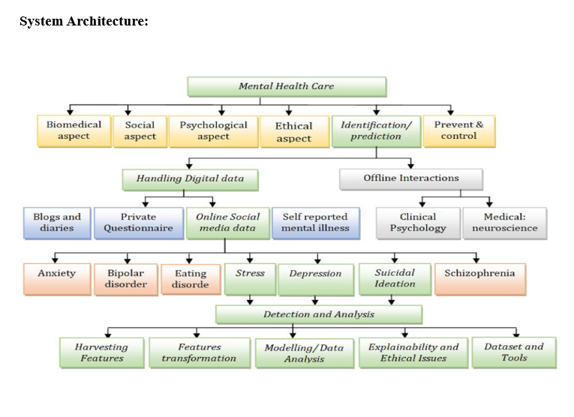

Slide 9
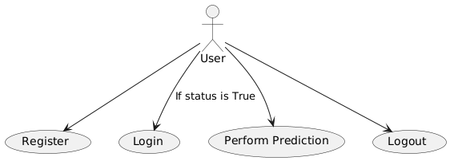
UML DIAGRAMS
USE CASE DIAGRAM

Slide 10
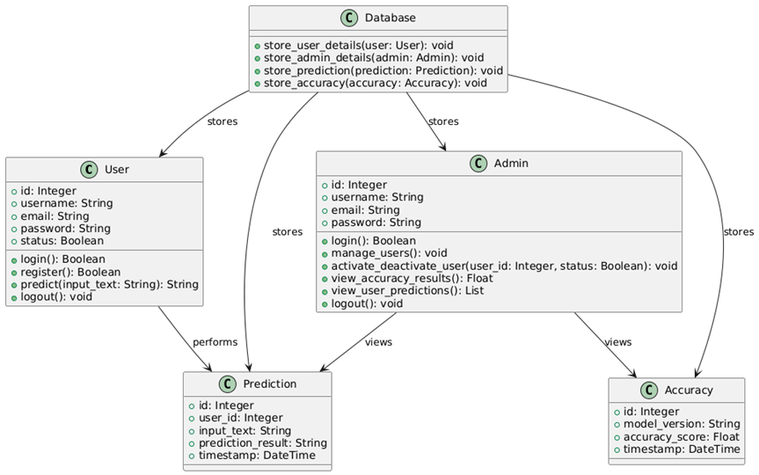
UML DIAGRAMS
CLASS DIAGRAM

Slide 11
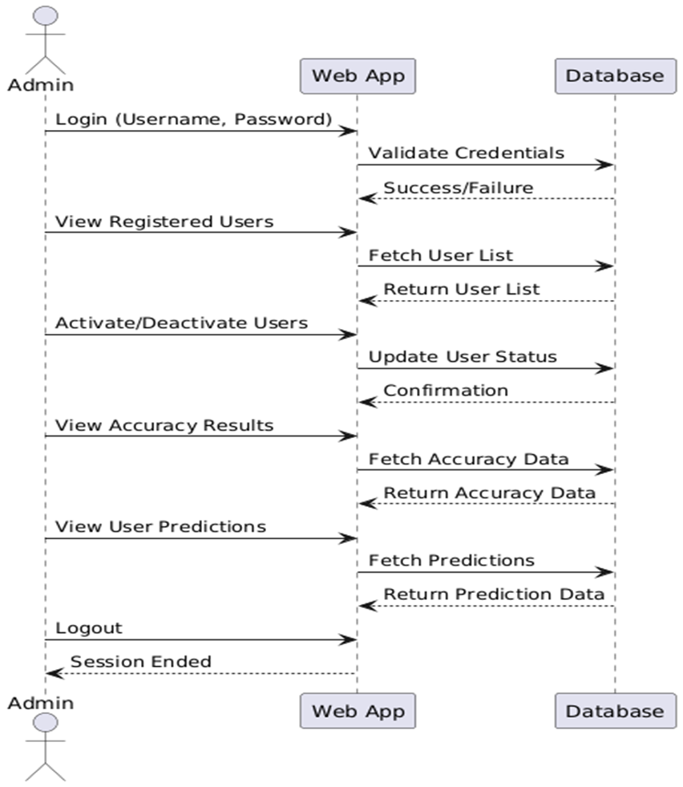
UML DIAGRAMS
SEQUENCE DIAGRAM

Slide 12
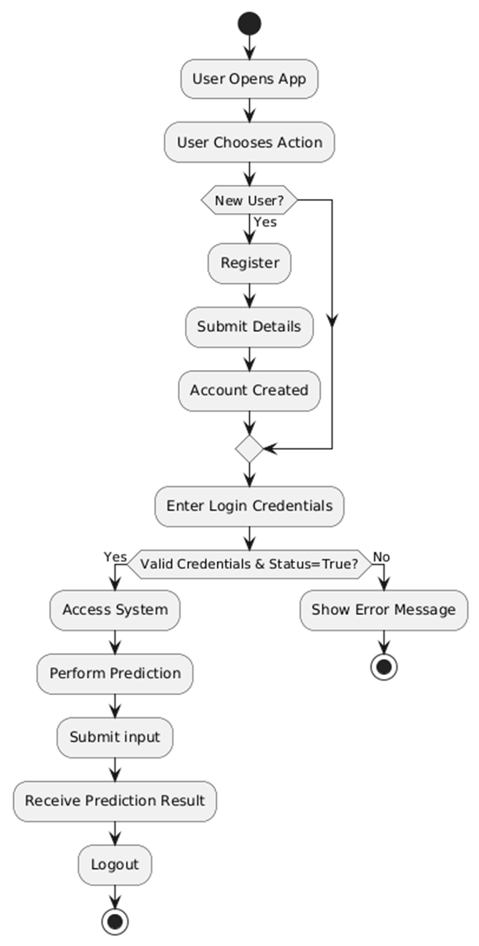
UML DIAGRAMS
ACTIVITY DIAGRAM

Slide 13
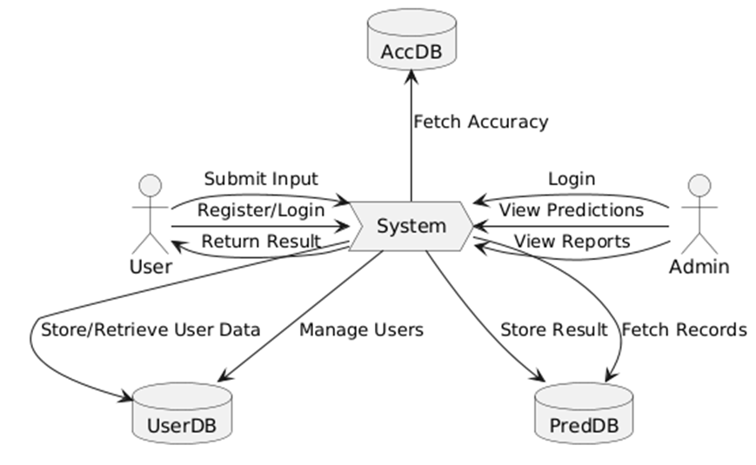
UML DIAGRAMS
DATA FLOW DIAGRAM

Slide 14
ALGORITHMS
Decision tree classifiersDecision tree classifiers are used successfully in many diverse areas. Their most important feature is the capability of capturing descriptive decision making knowledge from the supplied data. Decision tree can be generated from training sets. The procedure for such generation based on the set of objects (S), each belonging to one of the classes C1, C2, …, Ck is as follows:Step 1. If all the objects in S belong to the same class, for example Ci, the decision tree for S consists of a leaf labeled with this classStep 2. Otherwise, let T be some test with possible outcomes O1, O2,…, On. Each object in S has one outcome for T so the test partitions S into subsets S1, S2,… Sn where each object in Si has outcome Oi for T. T becomes the root of the decision tree and for each outcome Oi we build a subsidiary decision tree by invoking the same procedure recursively on the set Si.Gradient boosting Gradient boosting is a machine learning technique used in regression and classification tasks, among others. It gives a prediction model in the form of an ensemble of weak prediction models, which are typically decision trees.[1][2] When a decision tree is the weak learner, the resulting algorithm is called gradient-boosted trees; it usually outperforms random forest.A gradient-boosted trees model is built in a stage-wise fashion as in other boosting methods, but it generalizes the other methods by allowing optimization of an arbitrary differentiable loss function.

Slide 15
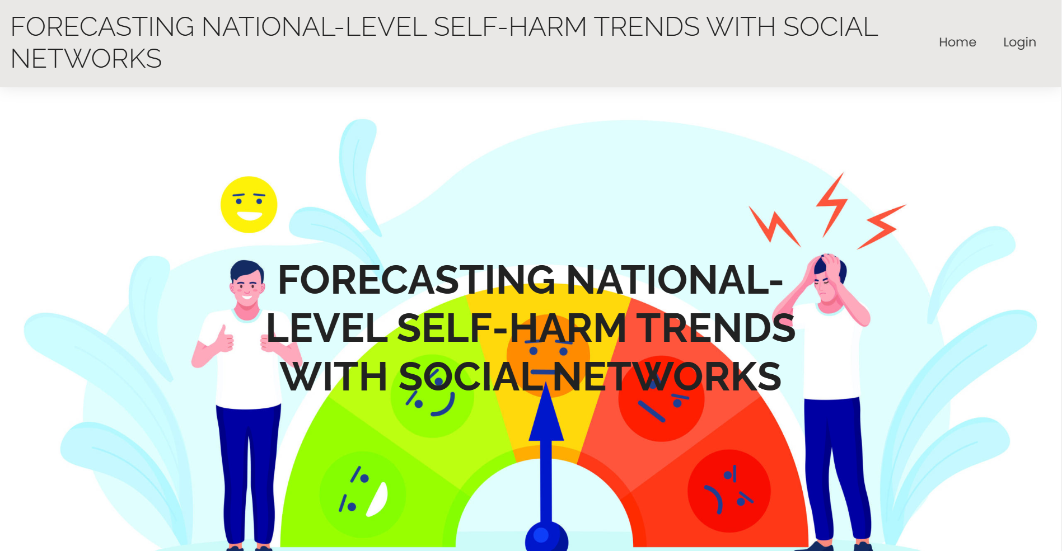
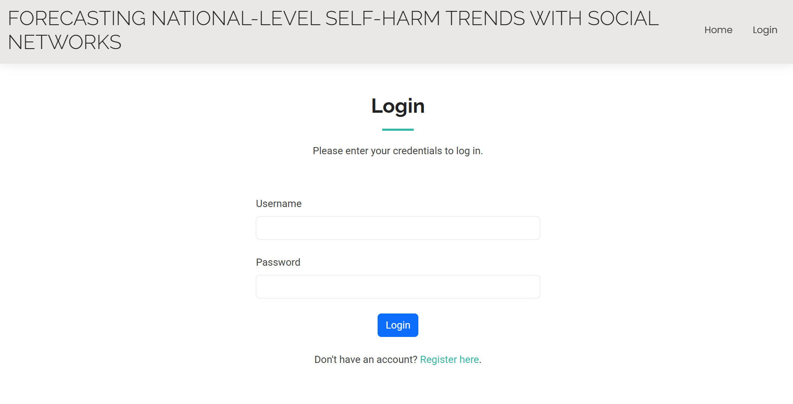
OUTPUT-SCREENS

Slide 16
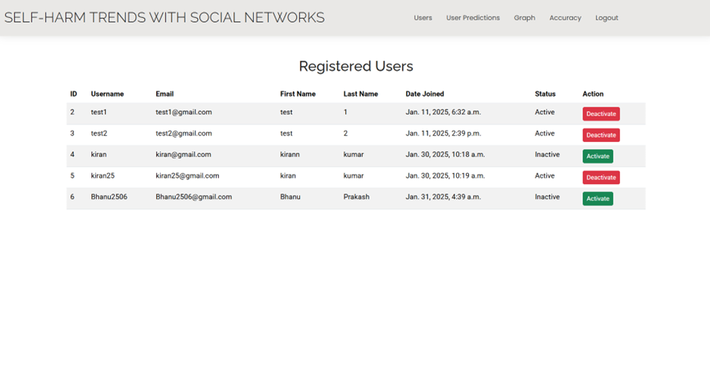
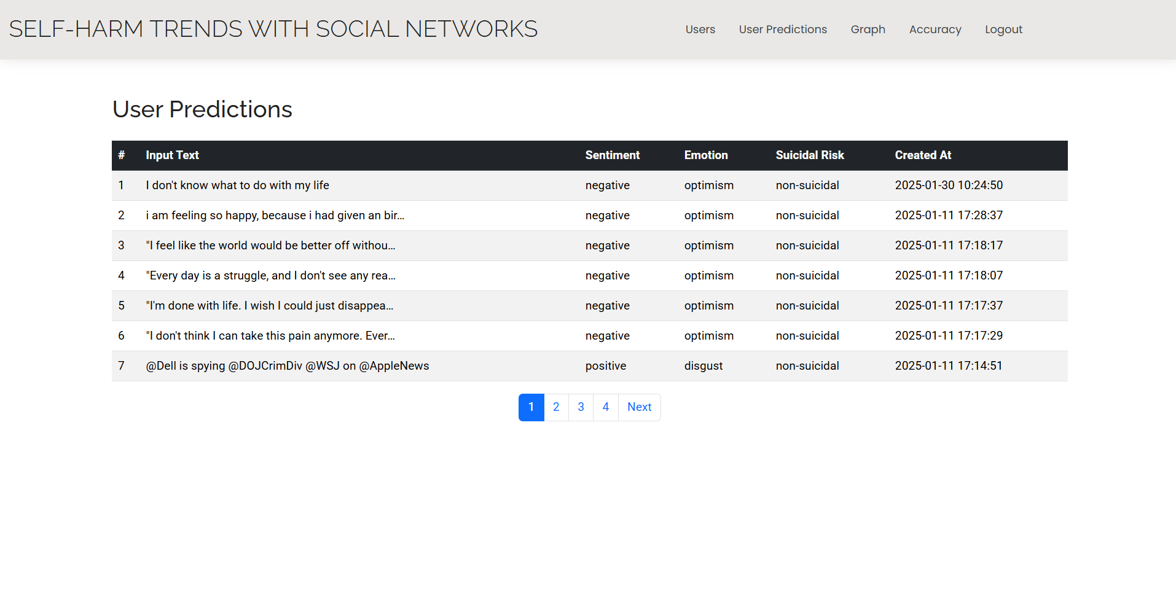
OUTPUT-SCREENS

Slide 17
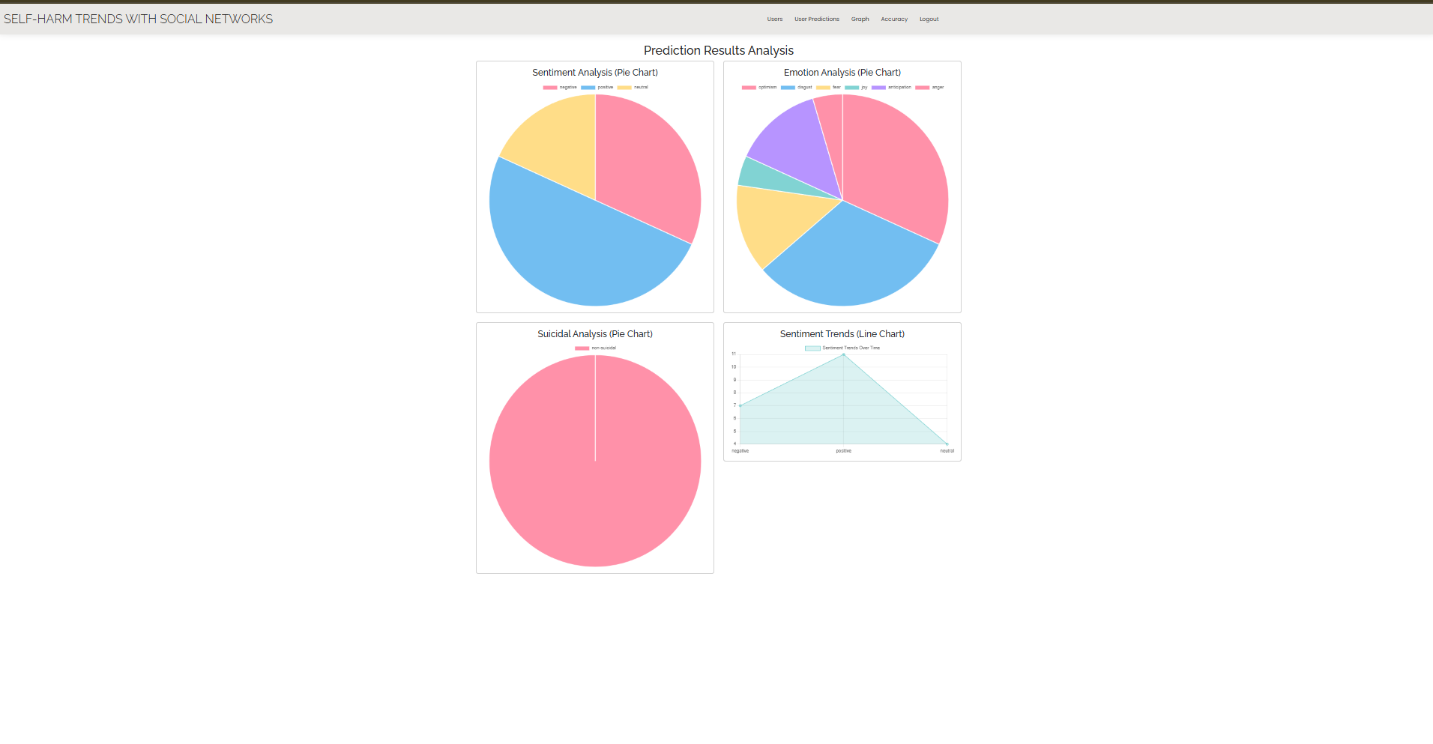
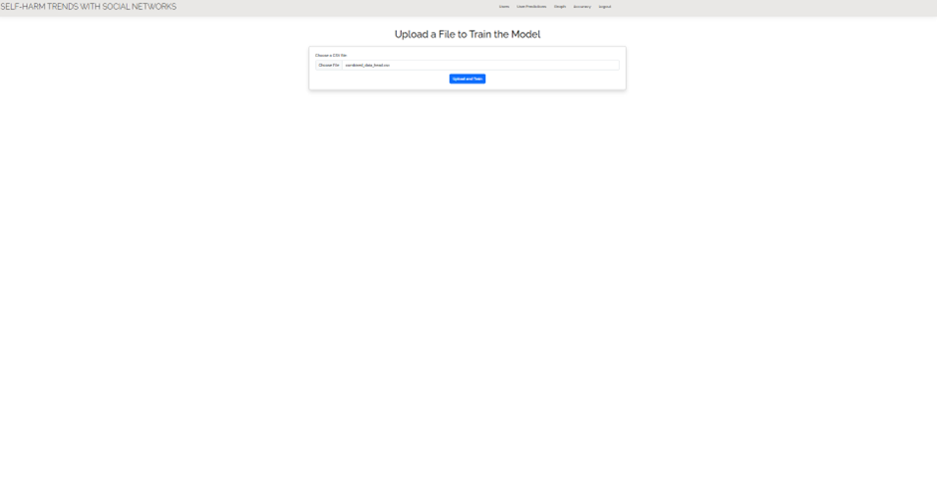
OUTPUT-SCREENS

Slide 18
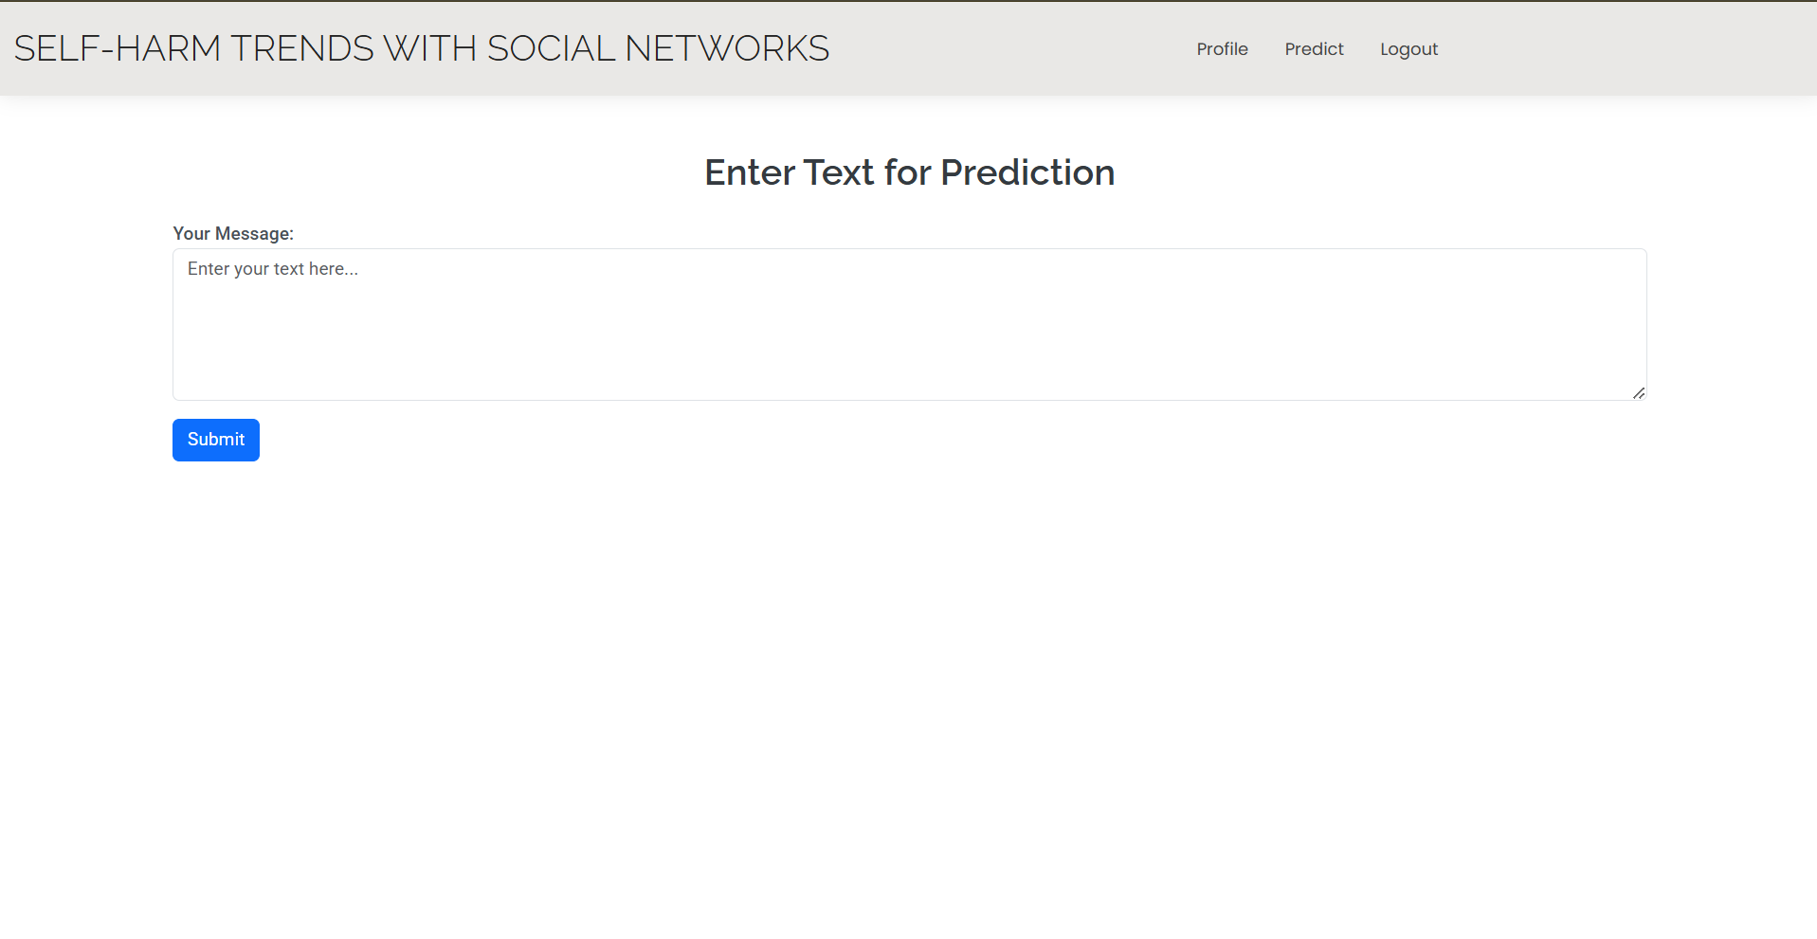
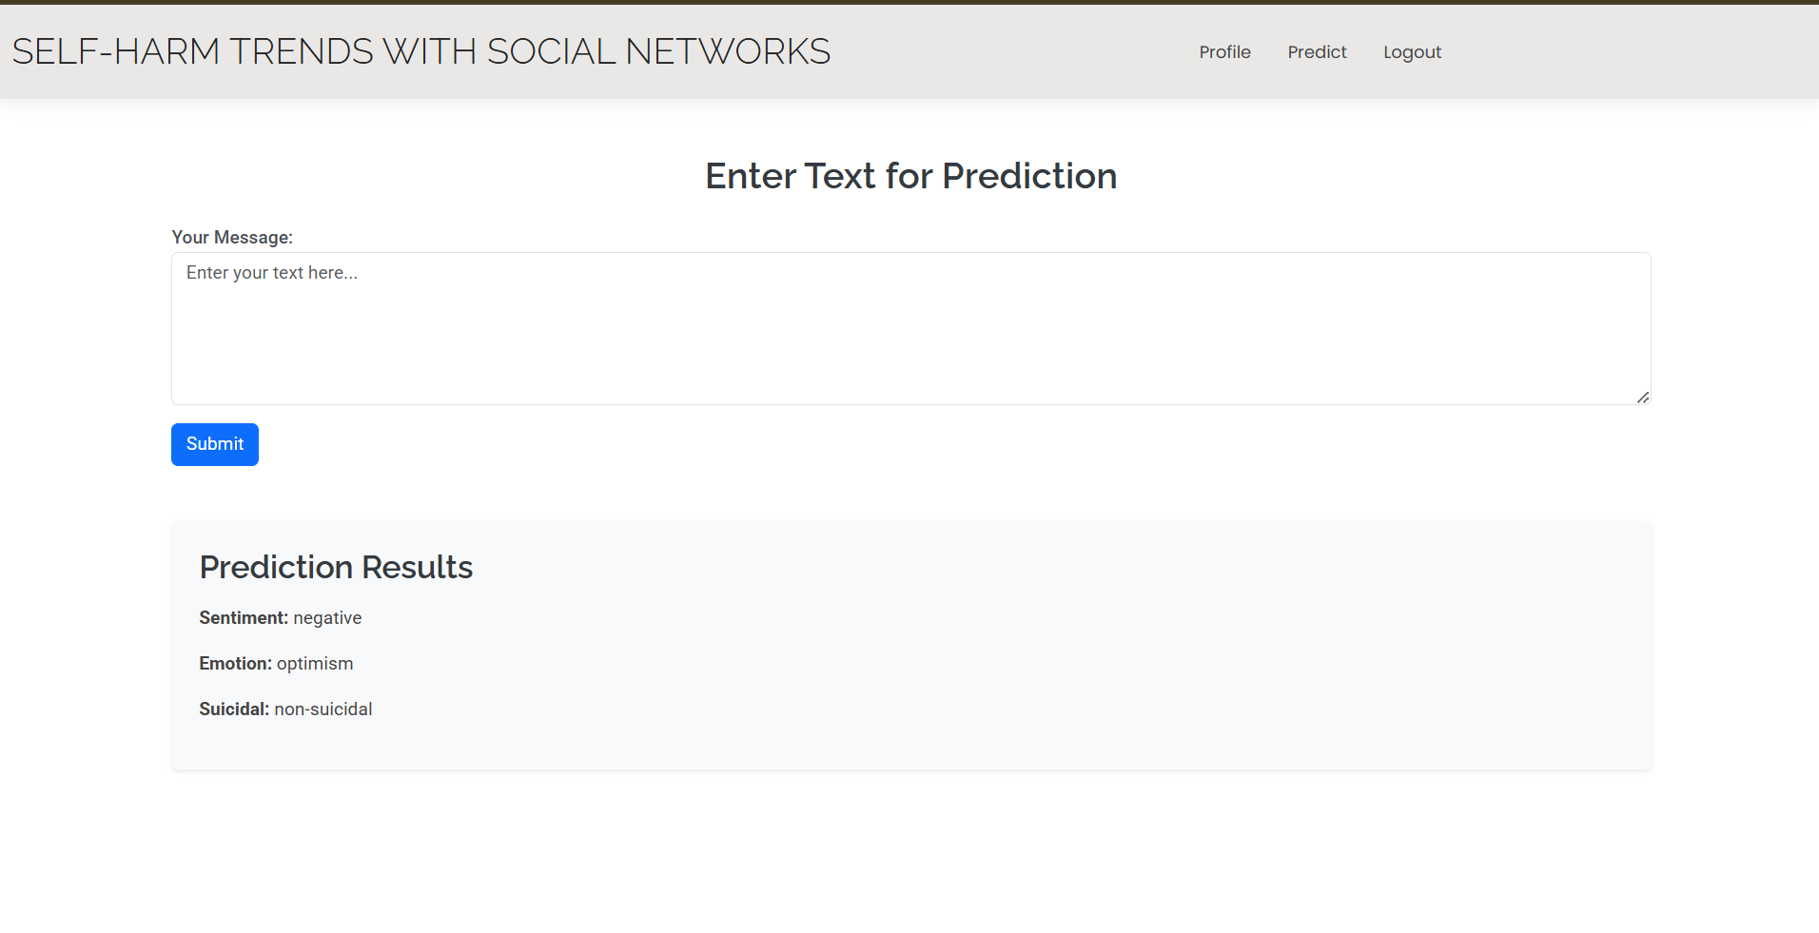
OUTPUT-SCREENS

Slide 19
CONCLUSION
Self-harm refers to acts of self-poisoning or self-injury that, regardless of intention, result in death or non-fatal injuries. Research has shown the rising trends of self-harm associated with the advent of technologies and rapid urbanization in developing countries. The ability to forecast or even nowcast national-level self-harm trends could prove crucial for policymakers and public health stakeholders in implementing timely procedures to neutralize the root causes or prevent these anticipated tragedies. While previous work has used historical statistics to forecast population-level self-harm, in certain countries, such ground-truth previous statistics may be unavailable, insufficient, and delayed, hindering the timely monitoring of the self-harm landscape for proactive policymaking purposes. This paper proposed FAST, a framework for forecasting population-level self-harm trends using mental signals extracted from large-scale social media data. A case study using a set of 12 mental signals extracted from tweets to improve the forecastability of the death and injury cases from self-harm in Thailand illustrated the applicability of the proposed method that outperforms the traditional ARIMA baseline by 43.56% and 36.48% on average in terms of MAPE, respectively. To the best of our knowledge, we are the first to investigate using aggregate social media data to improve nowcasting and forecasting self-harm cases at the national level. While the experimental results are promising,there is still room for improvement. Future research could investigate the use of other online media, such as news articles, other social media platforms, or types of media, such as videos or photos in addition to texts, as well as deep learning forecasting techniques. Moreover, it would be worthwhile to investigate the potential for predicting incidents of self-harm on a more granular, such as regional or demographic-specific, scale. This could facilitate the development of tailored self-harm management approaches that are appropriate for specific localities and demography.

Slide 20
REFERENCES
[1] (May 2023). Suicide Rates for Girls Are Rising. Are Smartphones to Blame? [Online]. Available: https://www.economist.com/graphic-detail/ 2023/05/03/suicide-rates-for-girls-are-rising-are-smartphones-to-blame
[2] J. Adam-Troian and T. Arciszewski, ‘‘Absolutistwords from search volume data predict state-level suicide rates in the United States,’’ Clin. Psychol. Sci., vol. 8, no. 4, pp. 788–793, Jul. 2020.
[3] A. E. Aiello, A. Renson, and P. Zivich, ‘‘Social media-and Internet-based disease surveillance for public health,’’ Annu. Rev. Public Health, vol. 41, p. 101, Apr. 2020.
[4] M. Akyuz and C. Karul, ‘‘The effect of economic factors on suicide: An analysis of a developing country,’’ Int. J. Hum. Rights Healthcare, Jul. 2022.
[5] S. Z. Alavijeh, F. Zarrinkalam, Z. Noorian, A. Mehrpour, and K. Etminani, ‘‘What users’ musical preference on Twitter reveals about psychological disorders,’’ Inf. Process. Manage., vol. 60, no. 3, May 2023, Art. no. 103269

